Slide 1
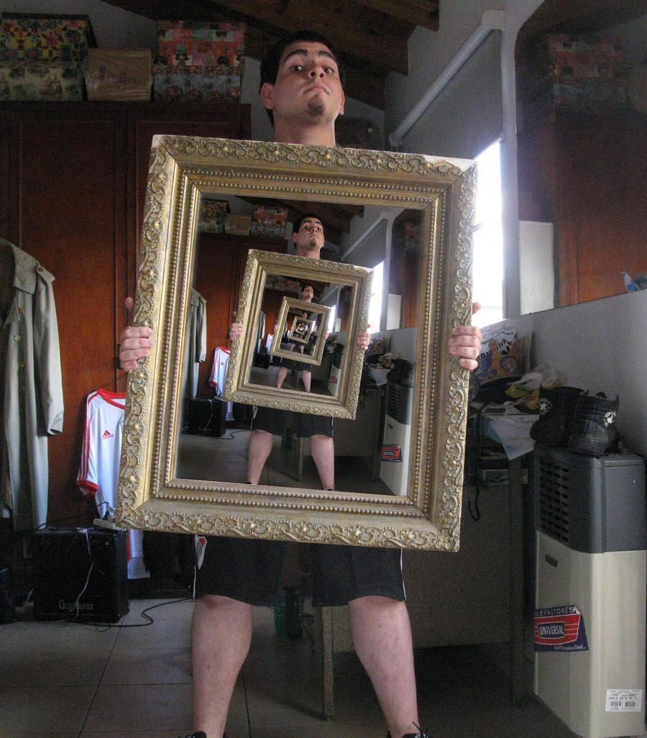
Intro to Recursion

Slide 2
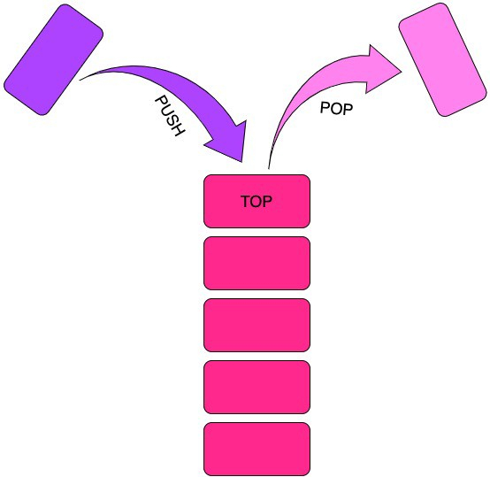
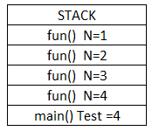
What is Recursion​?
Recursion is just function that call itself and is pushed to the stack each call.

Slide 3
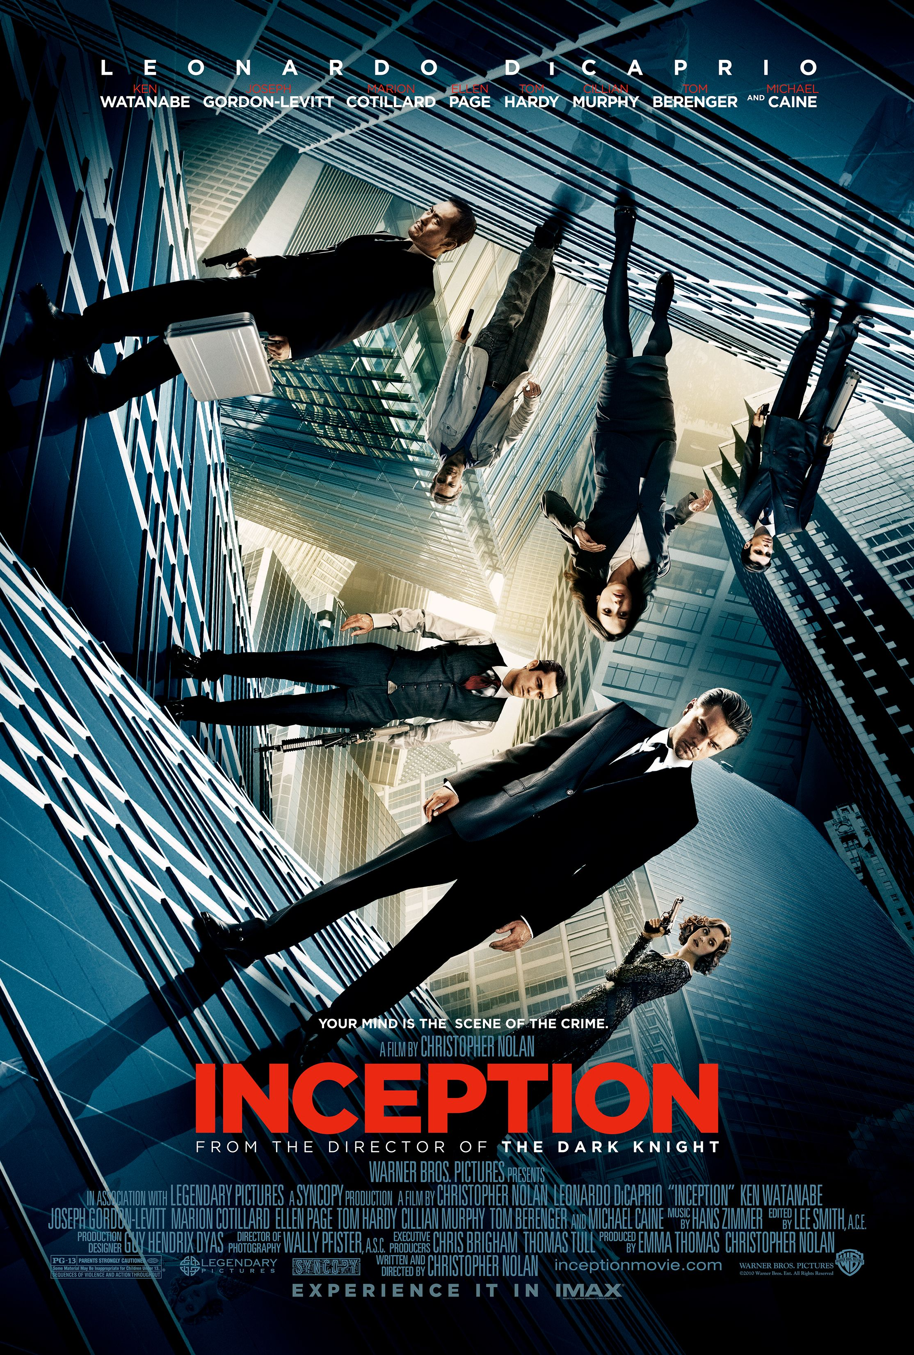
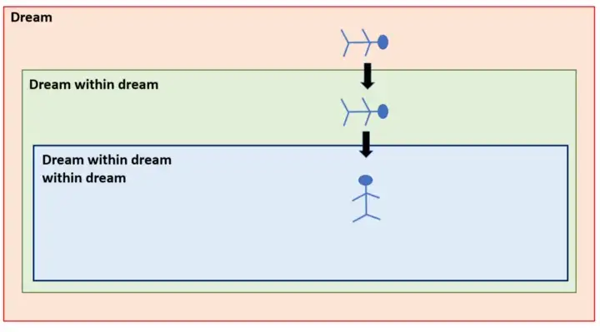
Perfect Analogy for Recursion is the movie Inception. The concept of “dream in a dream”

Slide 4
Three Laws to Recursion
1. A recursive algorithm must call itself, recursively.
2. A recursive algorithm must have a base case.
3. A recursive algorithm must change its state and move toward the base case.
.

Slide 5
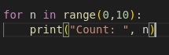
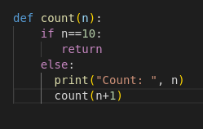
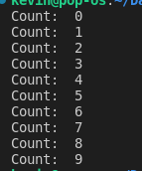
What is a Base Case
The Base case is the condition or statement which terminates the recursive function call. It’s Similar to a end loop statement .
Both functions output the same results, which is to count to 9. You can use this example to think of base case similar to loop statement.
Iterative Approach Recursive Solution Output

Slide 6
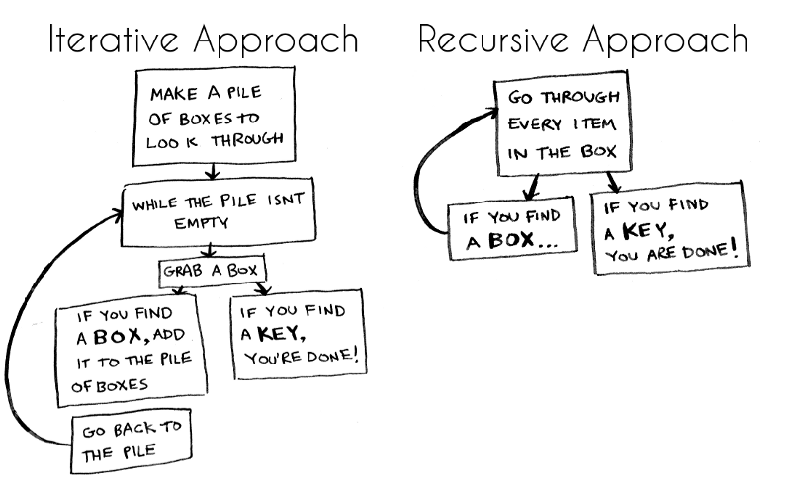

Slide 7
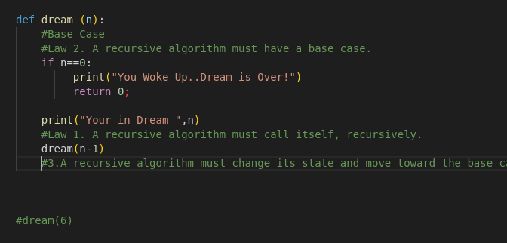
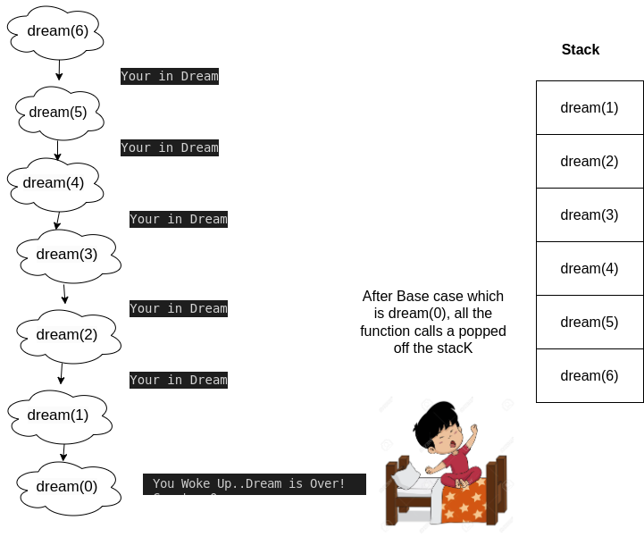
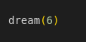
Recursive Inception Function
Main Function

Slide 8
Types of Recursion
1. Tail Recursion- A recursive function in which the last statement is a recursive call
2. Head Recursion – A recursive function in which is executed before the statements
3. Tree Recursion – A recursive function that has more than 1 recursive call, which results in the function branching into a three
4. Nested Recursion – A function that calls itself in the functions parameter
5. Indirect Recursion – A function is mutually called by another function in a circular manner

Slide 9
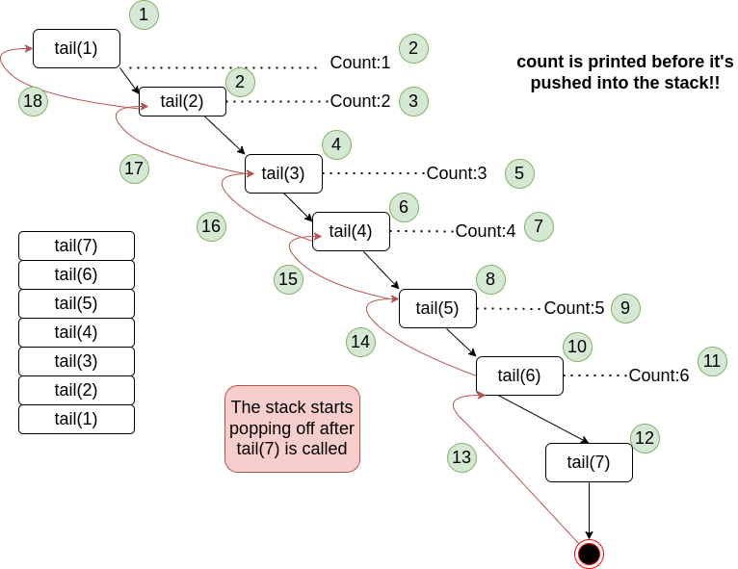
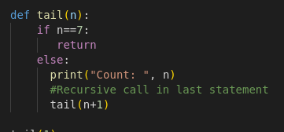
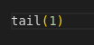
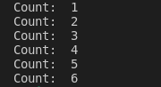
Tail Recursion
Main
Output:

Slide 10
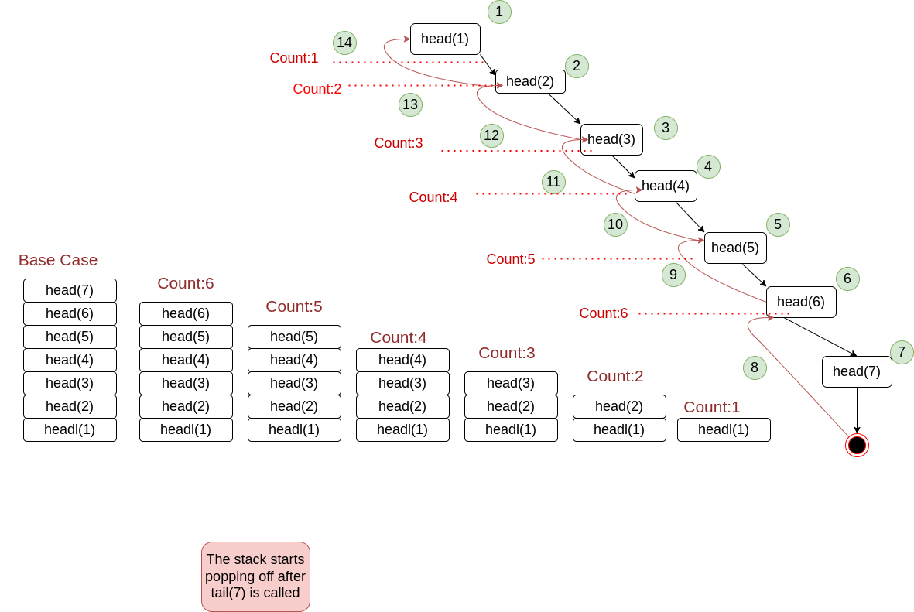
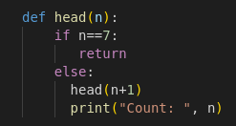
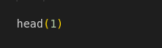
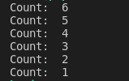
Head Recursion
Main
Output

Slide 11
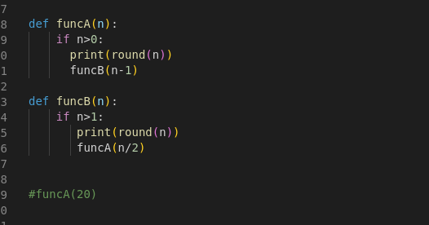
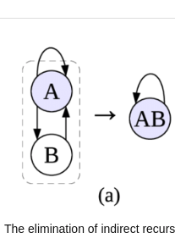
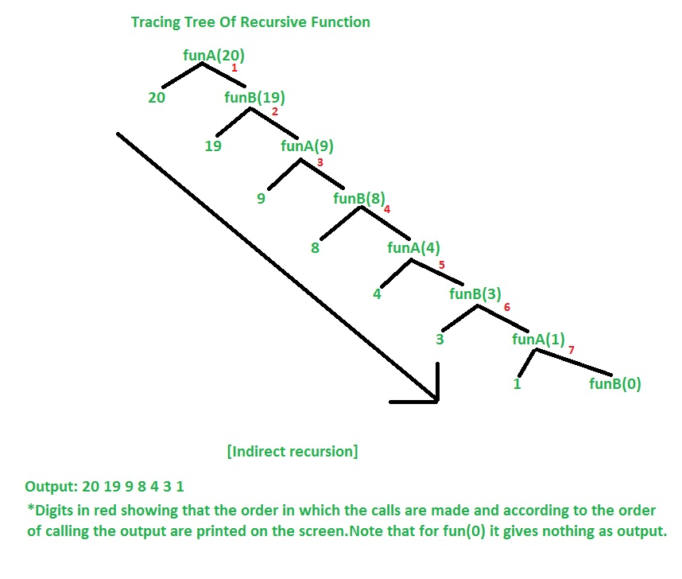

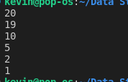
Indirect Recursion
Main
Output

Slide 12
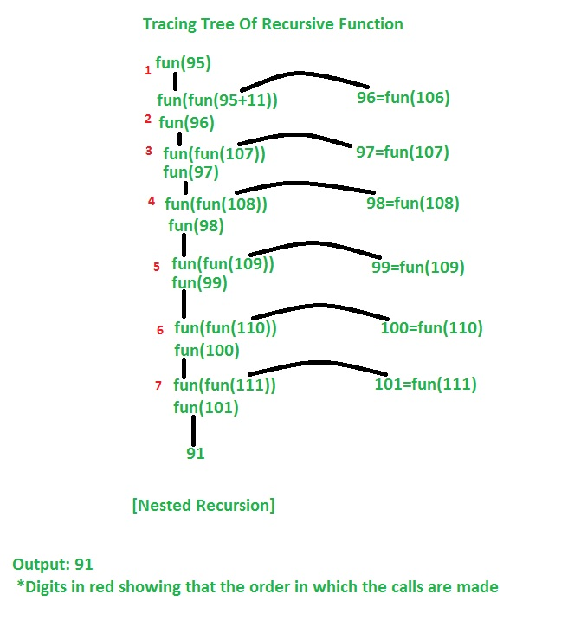
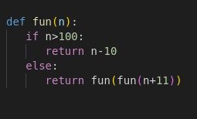
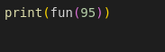
Nested Recursion
Main
Output

Slide 13
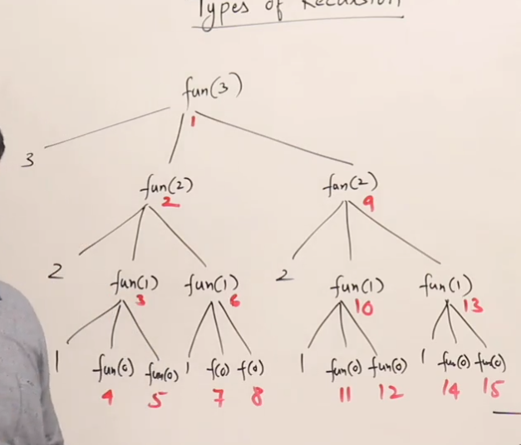
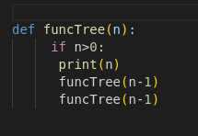
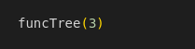
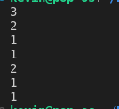
Tree Recursion
Main
Output

Slide 14
Code walk through for tree recursion

Slide 15
Thank you

